Slide 1
ICE CREAM MAKER AS AN ACCESSORY OF AN REFRIGERATOR
AALIM MUHAMMED SALEGH COLLEGE OF ENGINEERING DEPARTMENT OF MECHANICAL ENGINEERING
TEAM MEMBERS
N. MOHAMMED BILAL | 110119114033
JOGESHWARE RAO | 110119114305
F.KHAJA EZZAZUDTHEEN AHAMED | 110119114306
A. ARSHAD HASAN | 110119114701
GUIDE BY: Mr. P. MUNIRAJA CHANDRA, M.E., Ph.D

Slide 2
ABSTRACT
Here we are doing product development based on refrigeration. The purpose of the project is to develop another accessory for a refrigerator. This product will give the advantage of making ice cream in the refrigerator. The product will attach and detach from the refrigerator to make it more effective. The product’s simple working process is a high speed electric motor, geared at approximately 30rpm, drives a mechanism that simultaneously rotates the canister, counter-rotates the scraper, and holds the churn paddles stationary. As the canister turns, the ice cream mixture freezes against the inner wall of the canister

Slide 3
INTRODUCTION
A domestic ice cream maker is a machine used to make small quantities of ice cream for personal consumption. Ice cream makers may prepare the mixture by employing an electric motor. The resulting preparation is often chilled through either pre- cooling the machine or by employing a machine that freezes the mixture. An ice cream maker has to simultaneously freeze the mixture while churning it so as to aerate the mixture and avoid ice crystals. As a result, most ice creams are ready to consume immediately. Some machines, such as certain lower-priced countertop models, do require that the resulting mixture be frozen for additional time after churning is completed.

Slide 4


WORK PLAN
SI.NO | DESCRIPTION
WEEK 1 | Designing work for our model using CREO
WEEK 2 | Design calculations
WEEK 3 | Refining the design
WEEK 4 | Buying materials
WEEK 5 | Constructing electrical circuit
WEEK 6 | 3D printing the designed components
WEEK 7 | Refining the 3D printed parts
WEEK 8 | Fixing the electrical circuit
WEEK 9 | Assembling the 3D printed parts
WEEK 10 | Testing and Results

Slide 5
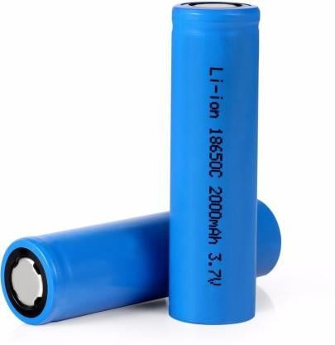
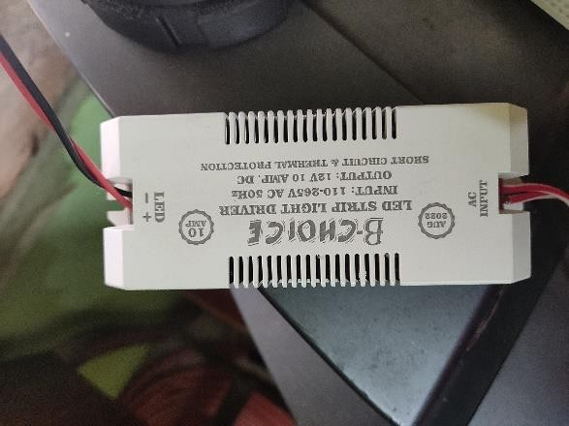
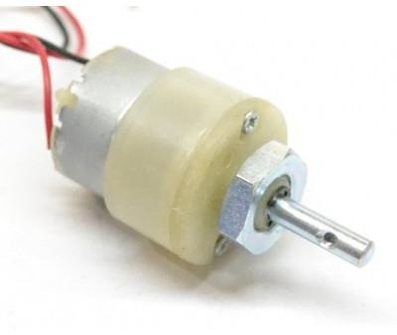
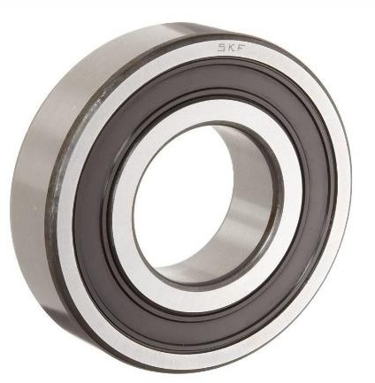
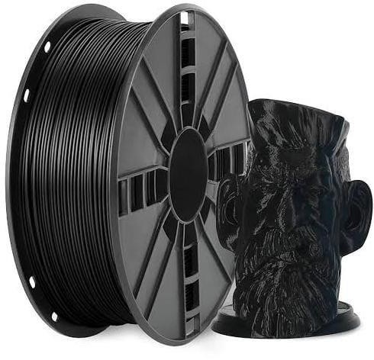
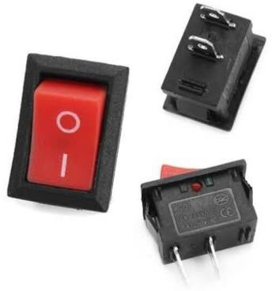
Lithium-ion Rechargeable Battery [4v,2amp]
PMDC Motor [30 rpm]
Adapter [12V, 10amp]
SPST Switch
PLA Filament
Bearing

Slide 6
SEQUENCE OF OPERATIONS
2D DRAFTING
3D MODEL
L-KEYWAY LOCK SYSTEM
ELETRICAL CIRCUIT DIAGRAM
ASSEMBLED DRAWING
3D PRINTED PARTS
NO LOAD TEST RUN

Slide 7
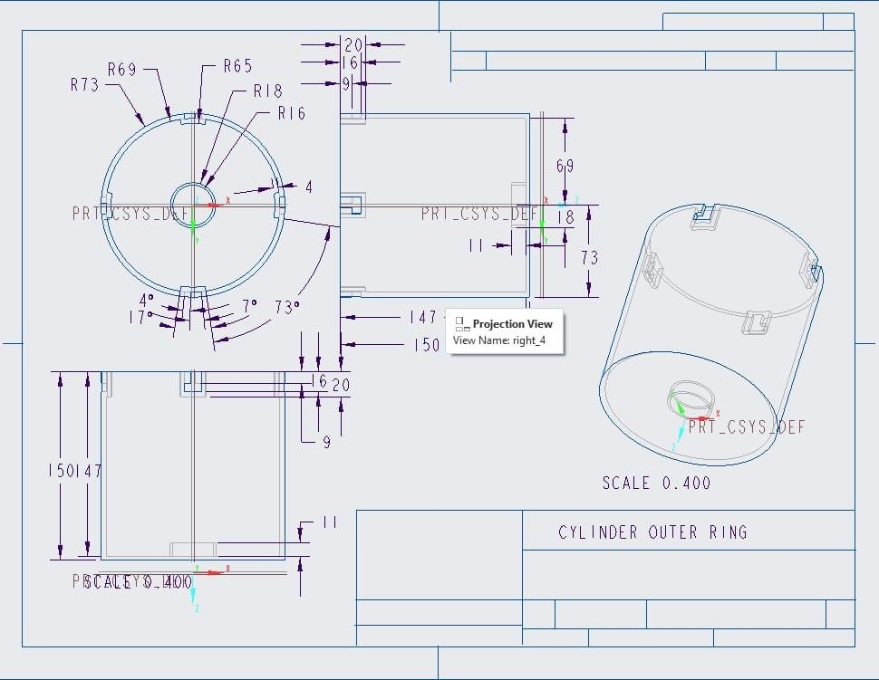
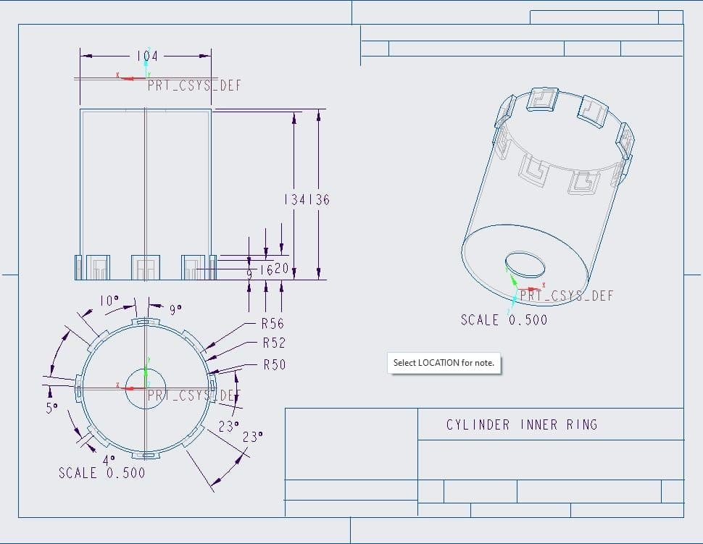
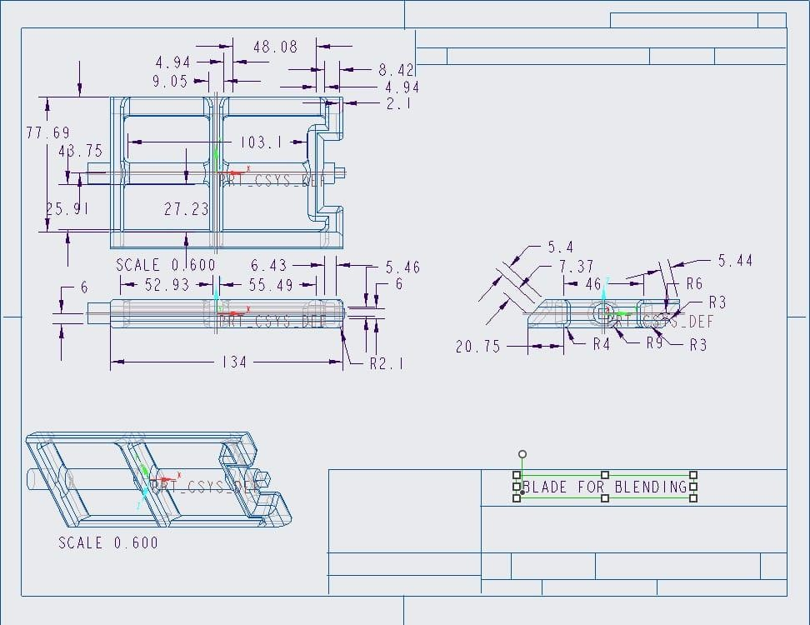
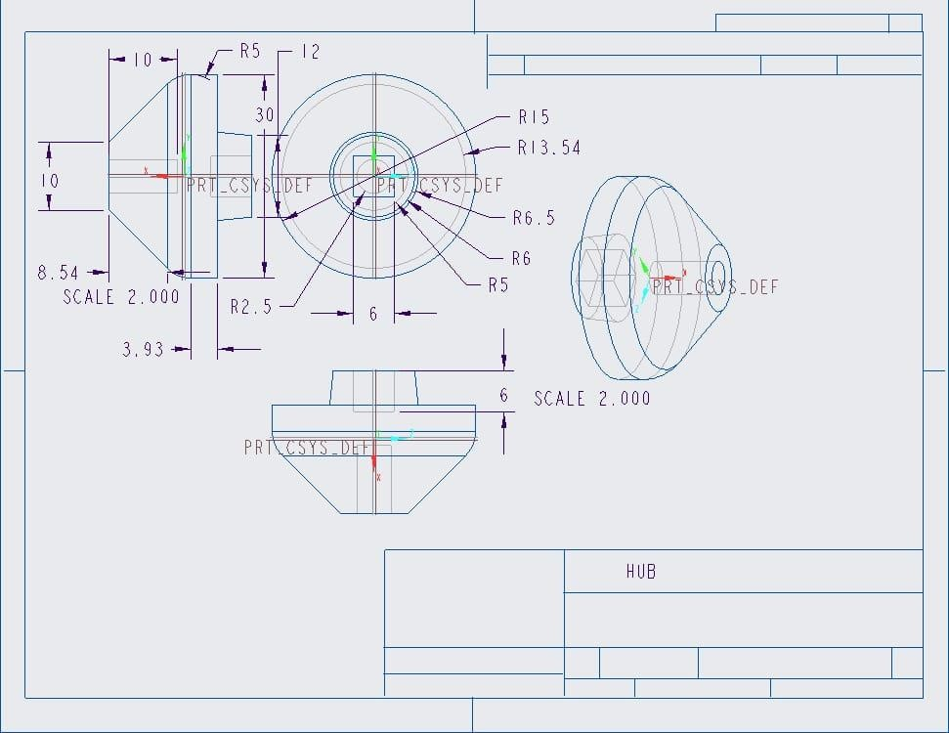
2D DRAFTING
Outer Cylinder.
Inner Cylinder.
Blade.
Hub.

Slide 8
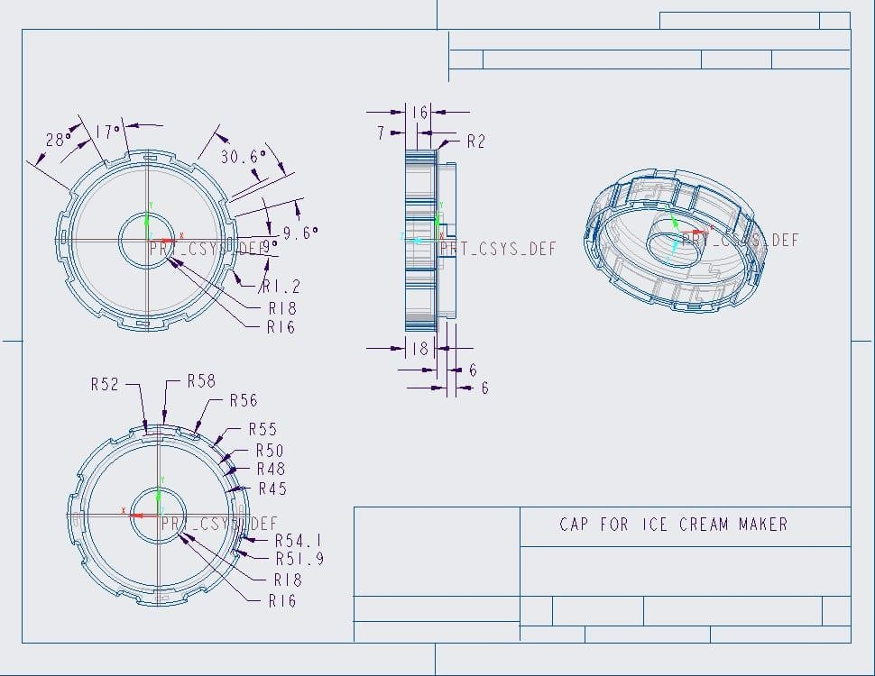
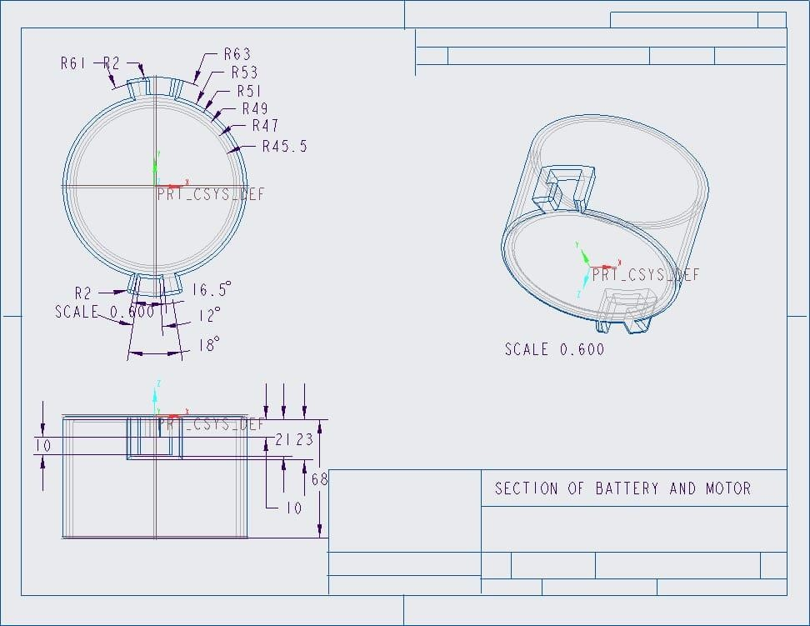
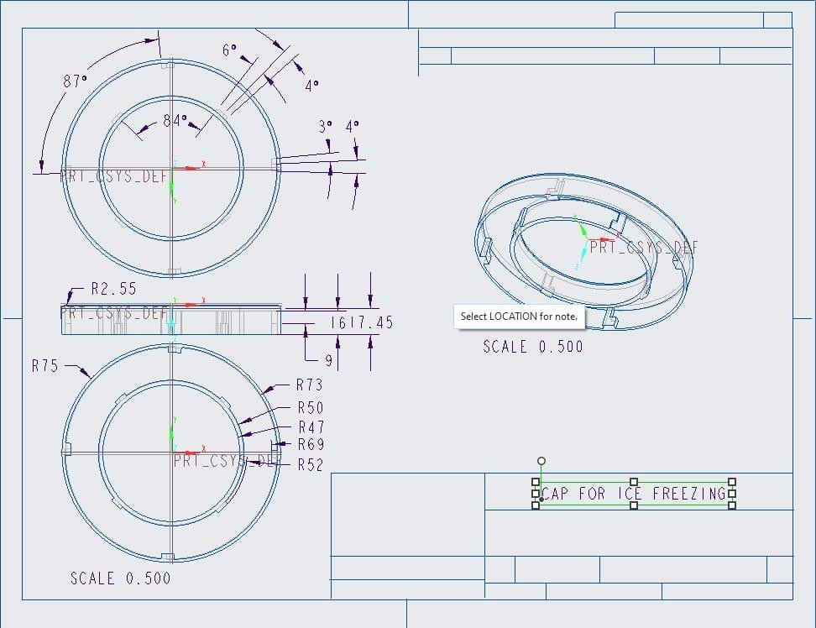
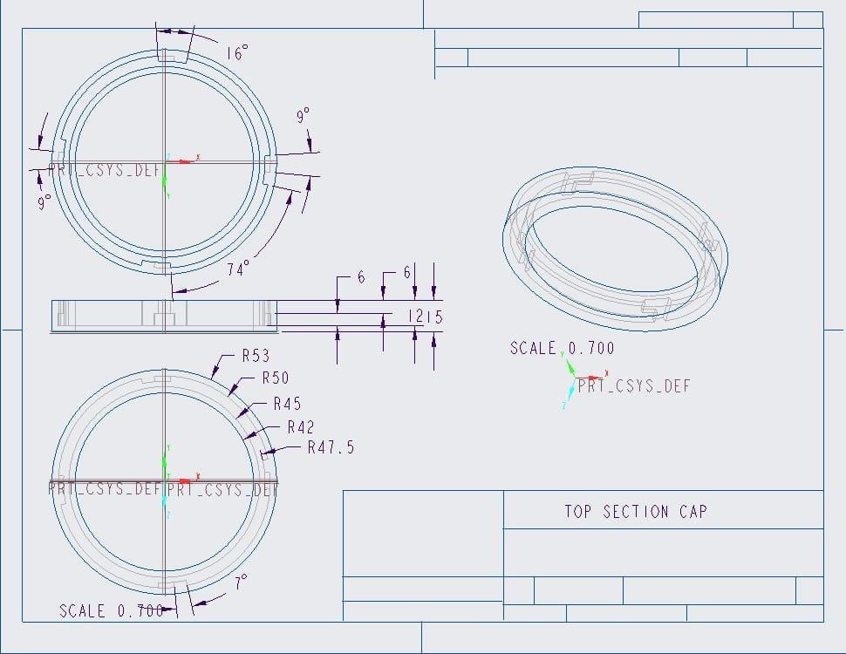
Cap2.
Moter And Battery Section.
Cap1.
Top Section Cap.

Slide 9
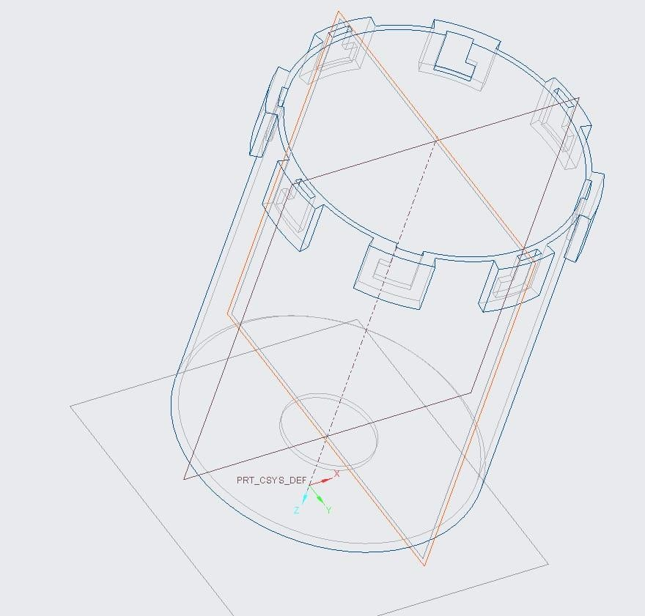
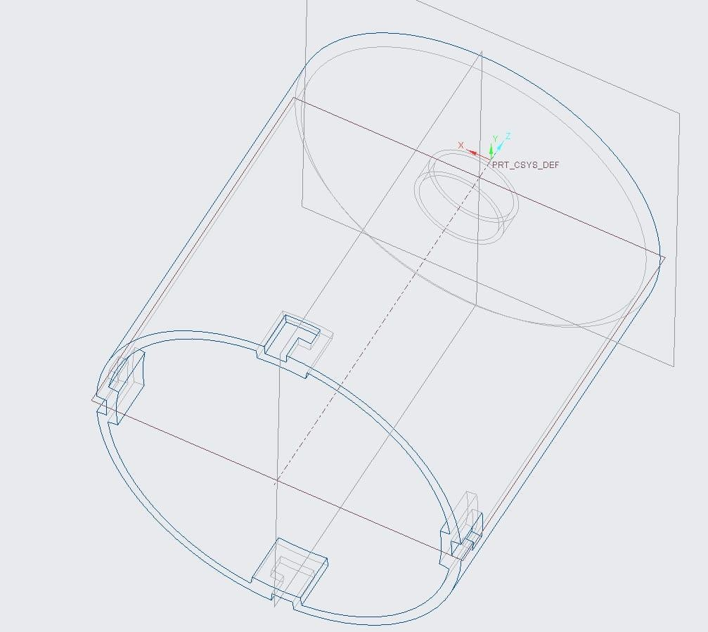
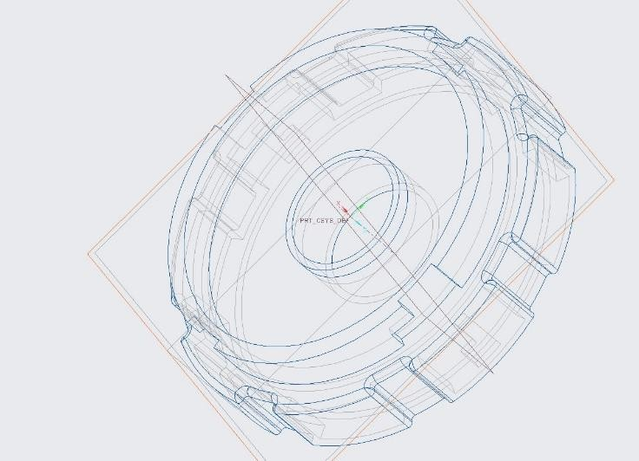
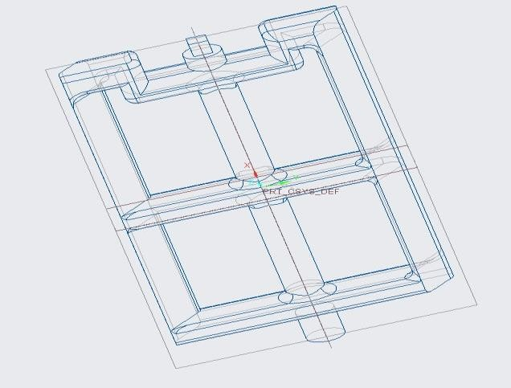
3D MODEL
3D Inner Cylinder.
3D Outer Cylinder.
3D Cap2.
3D Blade.

Slide 10
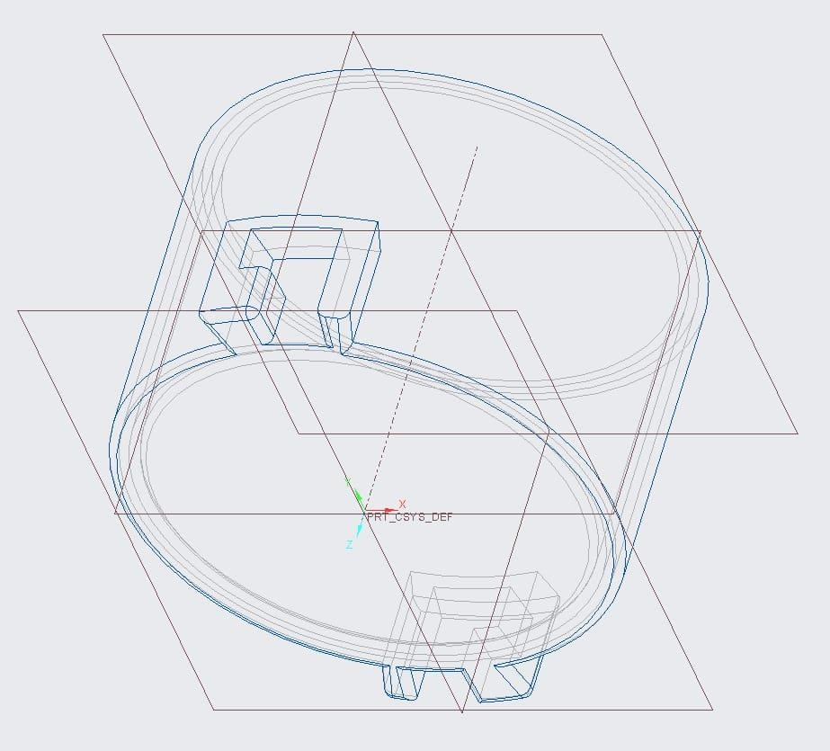
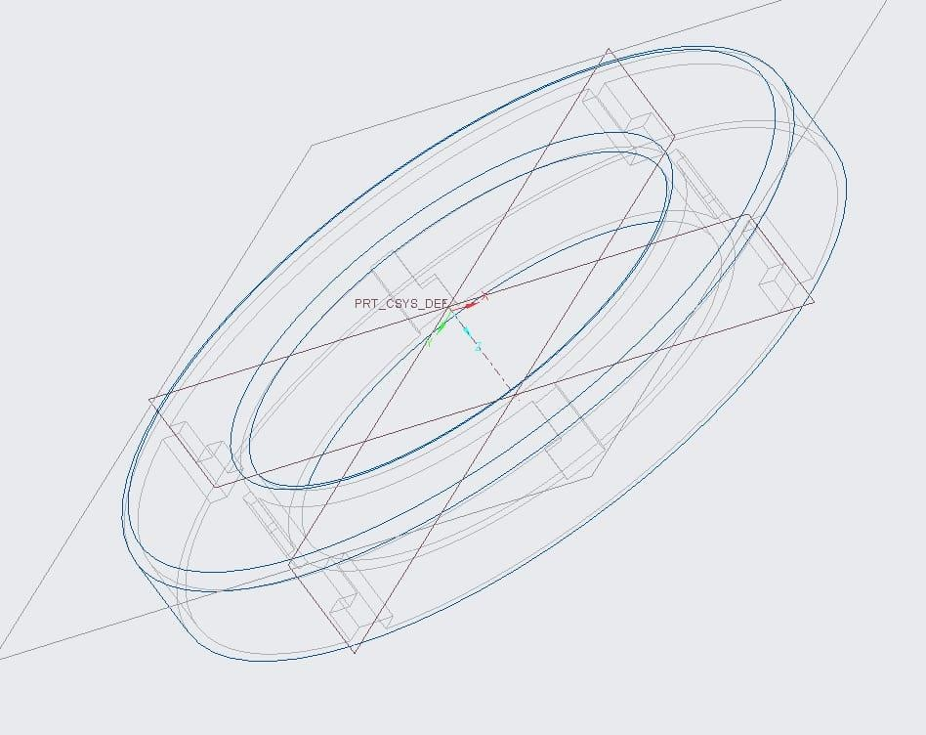
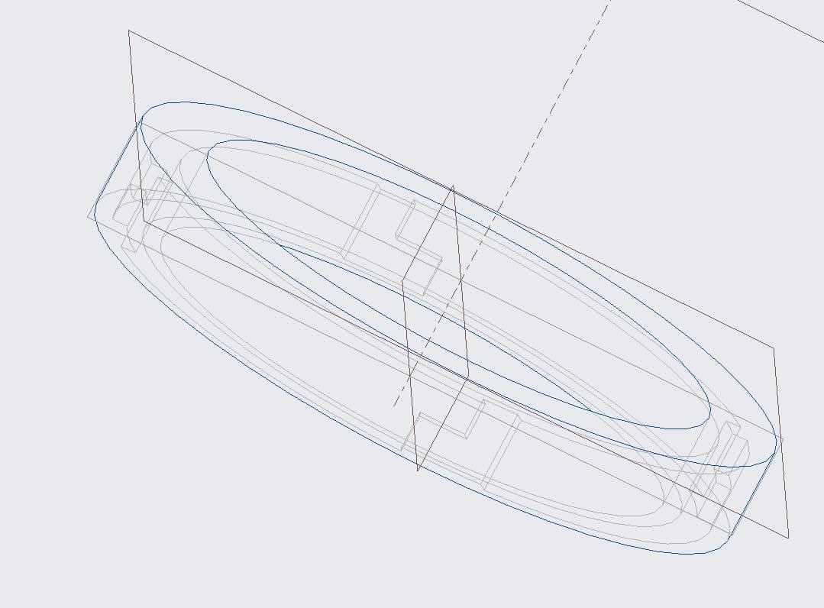
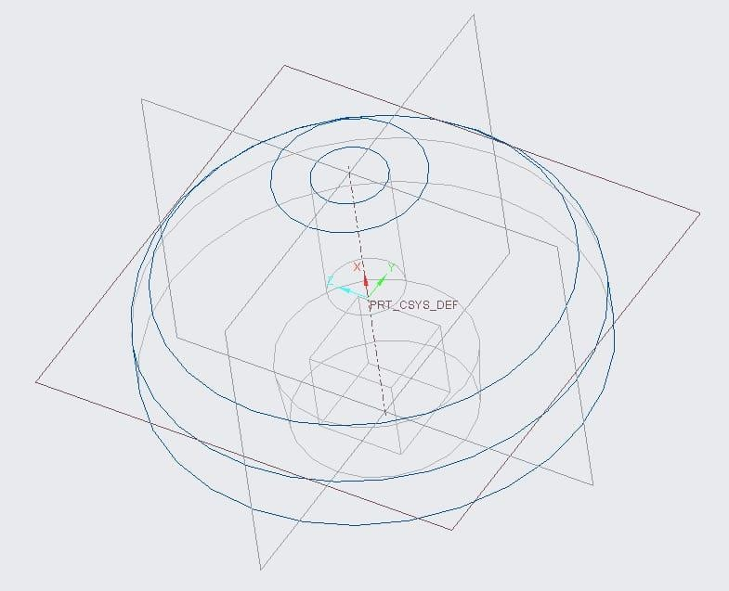
3D Moter And Battery Section.
3D Cap1.
3D Top Section Cap.
3D Hub.

Slide 11
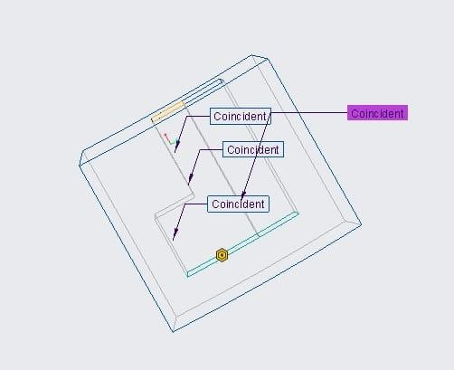
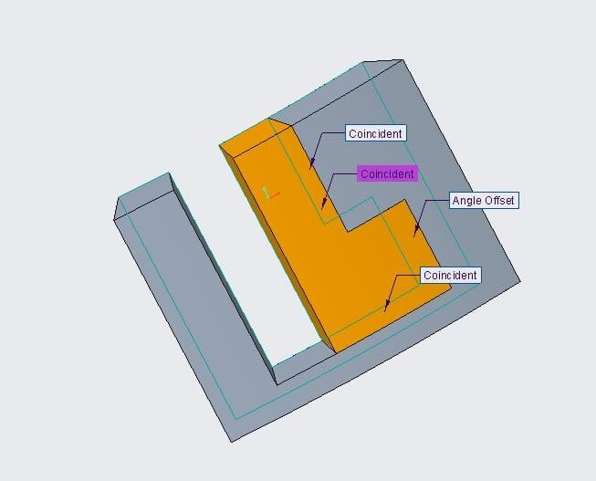
L-KEY WAY LOCK SYSTEM
The "L keyway lock system" is a type of lock mechanism that uses a specific keyway profile called the "L keyway." The key has an L-shaped groove that matches the lock cylinder's internal components. When the L key is inserted and turned, it aligns the grooves, allowing the lock to open or close.

Slide 12
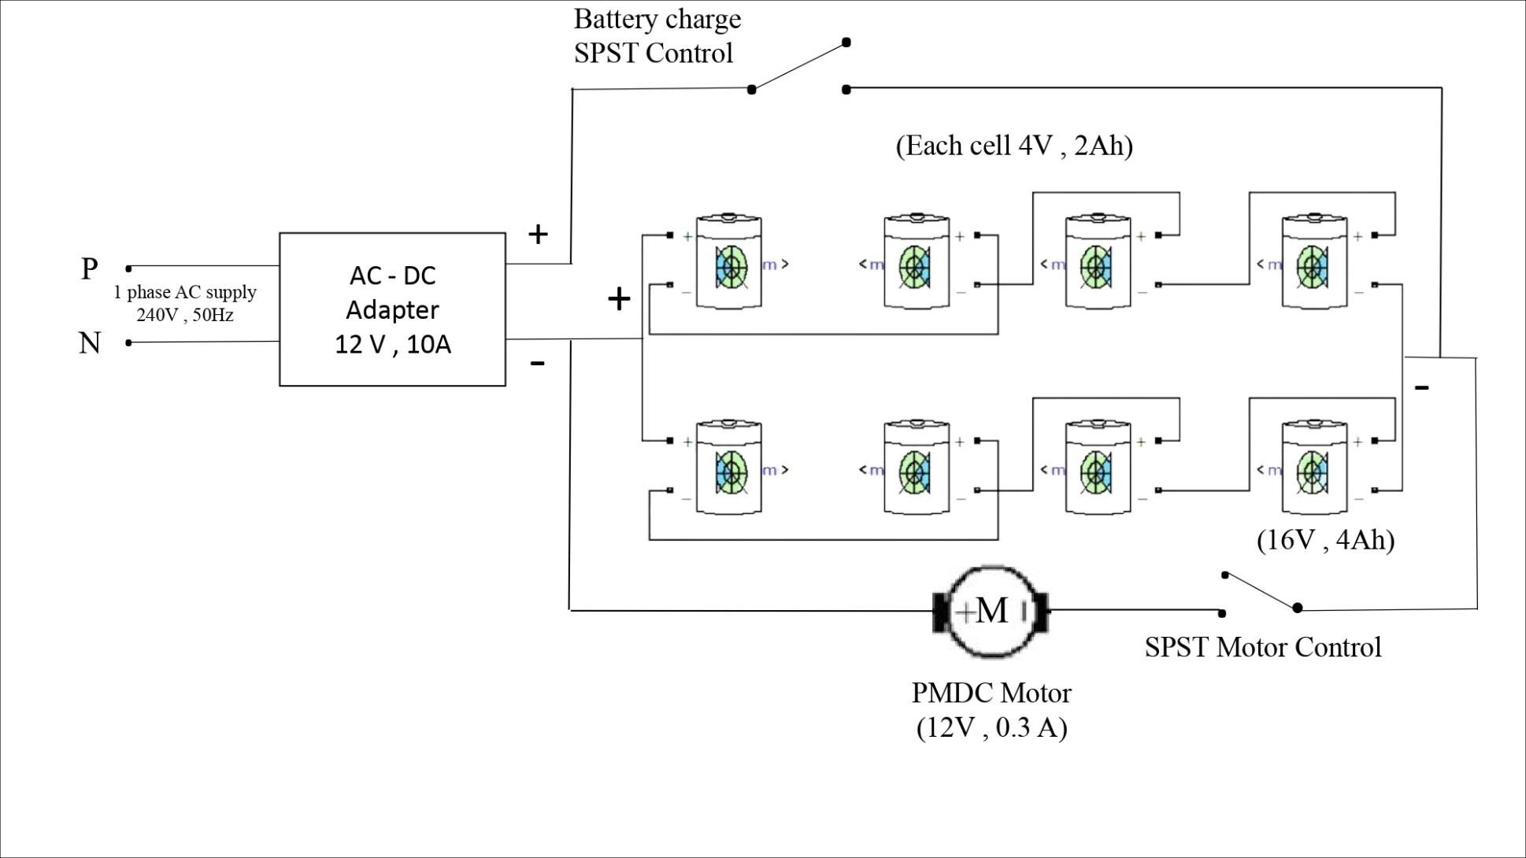
ELECTRICAL CIRCUIT DIAGRAM

Slide 13
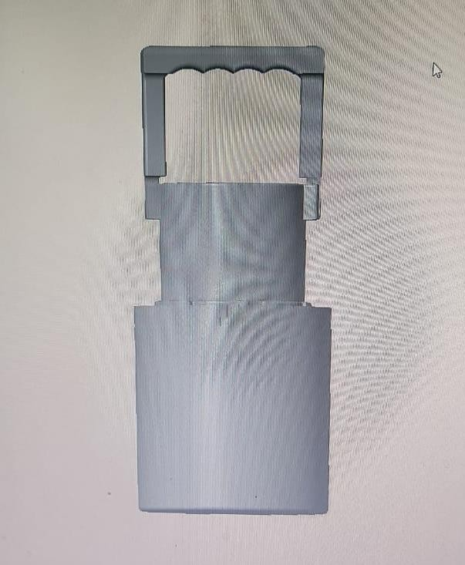
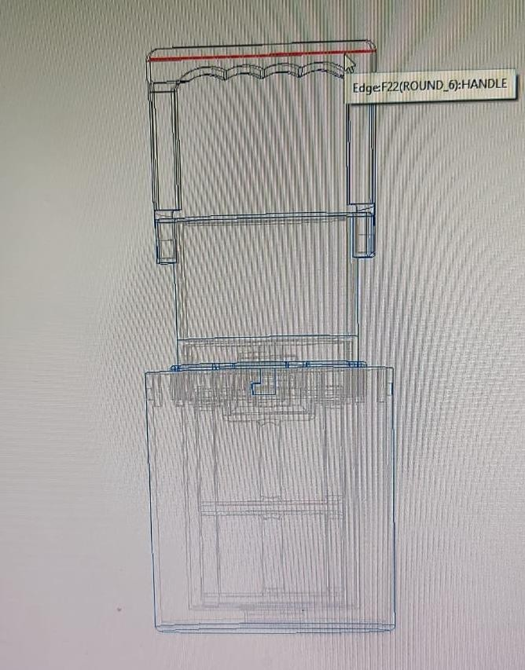
ASSEMBLED DRAWING
3D Model.
2D Drafting.

Slide 14
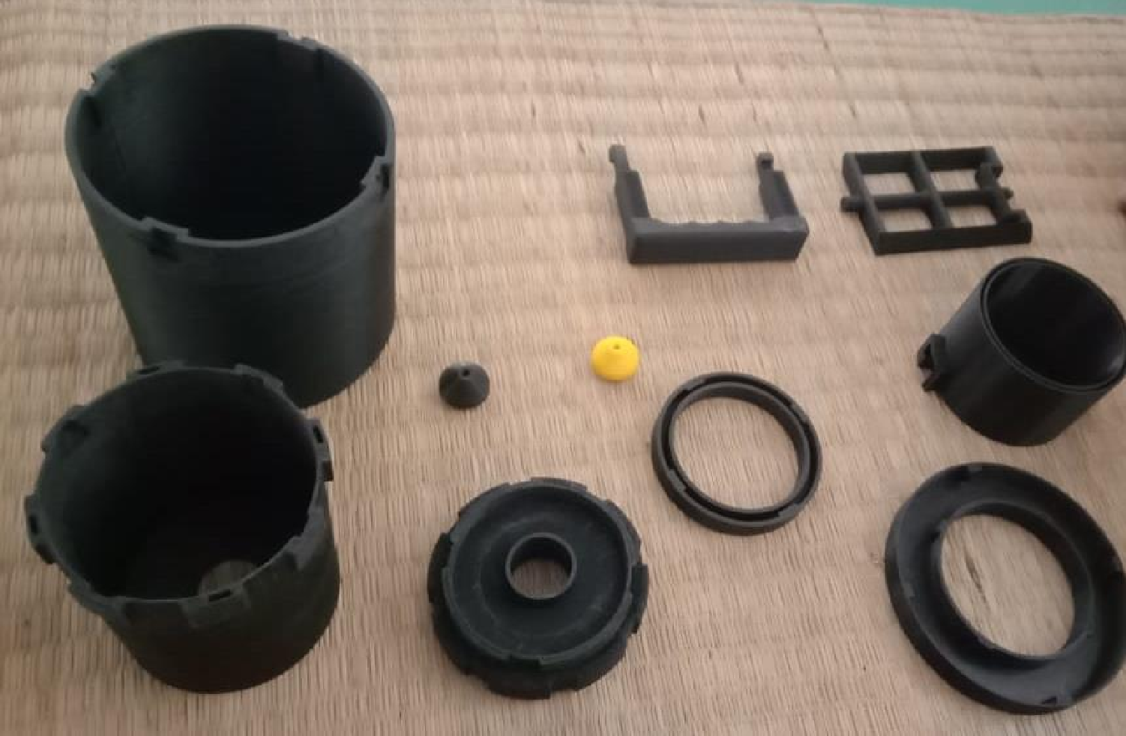
3D PRINTED PARTS

Slide 15
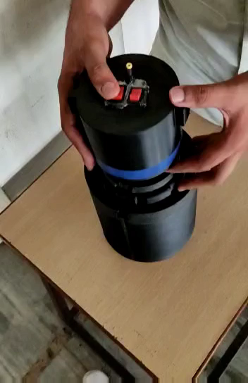
NO LOAD TEST RUN

Slide 16
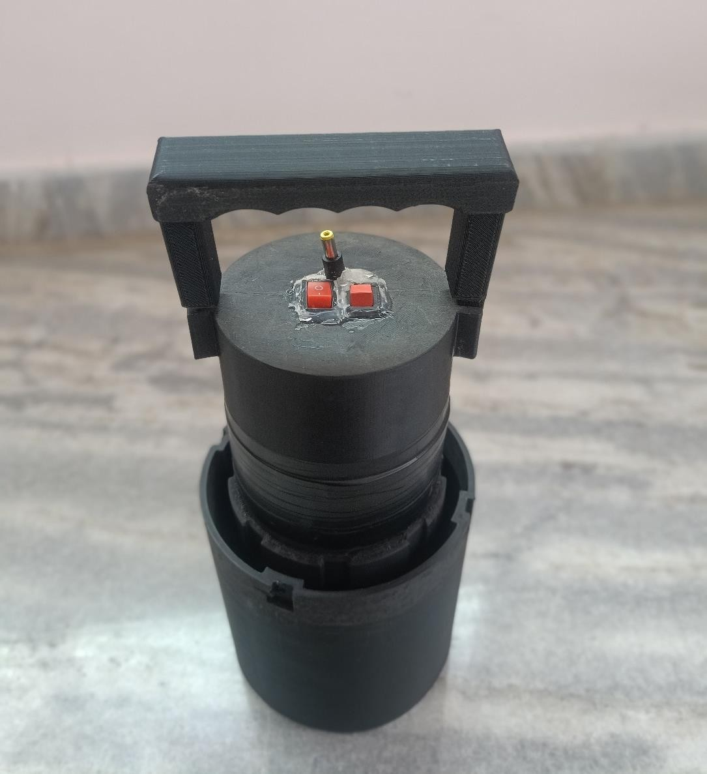
FINAL PRODUCT

Slide 17

FINAL RESULT

Slide 18
FINANCIAL MANAGEMENT
SNO | MATERIAL | COST
1 | PLA FILAMENT | 900
2 | BATTERY & HOLDER | 715
3 | MOTOR | 300
4 | ADAPTER & MULTIMETER | 470
5 | PRINTING SERVICES | 5300
6 | BEARING (2NOS) | 300
7 | INGREDIENTS | 300
8 | GLUE STICK | 60
9 | CARBON PAPER | 50
10 | SPST SWITCH | 25
11 | OVERHEAD | 580
 | TOTAL | 9000

Slide 19
CONCLUSION
Manufacturing modern ice cream makers typically involves the use
of electric motors and automated processes to produce ice cream.
This allows for greater efficiency and consistency in the production process compared to manual methods used in vintage ice makers.
Advances in technology have also allowed for the creation of various features and settings that can produce different types of ice cream, making modern ice cream makers more versatile and user- friendly.

Slide 20
WHAT’S NEXT
Choose a suitable potentiometer for the motor's specifications.
Wire the potentiometer: Connect one end to the power supply's positive terminal, the other end to ground/negative, and the wiper to the motor's speed control input.
For voltage control: Connect the wiper to the motor's voltage control
pin, adjusting the voltage with the potentiometer.
For current control: Vary the resistance in series with the motor using the potentiometer to adjust the current and control speed.
Calibrate by testing RPM at different potentiometer settings and make necessary adjustments for desired speed range. Additional circuitry like amplifiers or feedback loops may be needed for precision.

Slide 21
REFERENCES:
Johnson, George D. (2011). Profiles In Hue. Xlibris Corporation. p.
62. ISBN 9781456851200.
Chris Clarke (2012). The Science of Ice Cream. Royal Society of Chemistry. pp. 7–. ISBN 978-1-84973-127-0.
Mary Ellen Snodgrass (29 December 2004). Encyclopedia of
Kitchen History. Routledge. pp. 504–. ISBN 978-1-135-45572-9.
Johnson, Nancy (9 Sep 1843). "Artificial Freezer Patent" (PDF). Google Patents.
Alburger, Shaunta (24 Apr 2017). "The Effects of Salt on Ice
Cubes". Sciencing.

